Slide 1
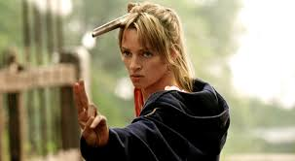
Bellwork: pick up your hero writing from the basket
You will also need your notebook
open to p. 22

Slide 2
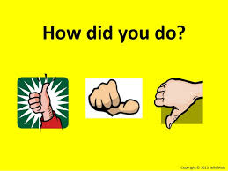
Bellwork (10 min) 1) Pick up your hero writing from the black bin 2) Look over the comment cards attached
3) Fix as many places where you marked colors 5 and 6 as possible
Color 5 = “Does Not Follow” in logic or sequence
Color 6 = Technical/grammar errors

Slide 3
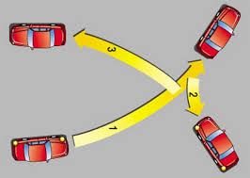
3-point review (notebook p. 23) with a partner, create a triangle for each text below as shown
WHO IS THE HERO? DESCRIBE IN ONE WORD?
HOW CHARACTERS ARE ARCHETYPAL
Green Book Texts:
Beowulf p. 41
Sir Gawain and the Green Knight p. 171
Pardoner’s Tale p. 125
Wife of Bath’s Tale p. 139
Handouts:
My Two Lives p. 568
Driving While Stupid p. 571
THEMES

Slide 4
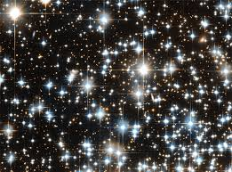
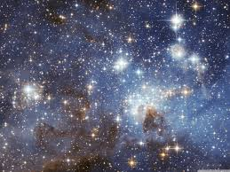
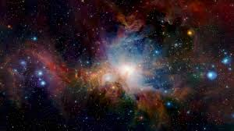
Bright stars in your writing – 5 min
Reread your original writing for places you might be able to include elements from the triangles
When you find one, place a star next to the location you think it should go

Slide 5
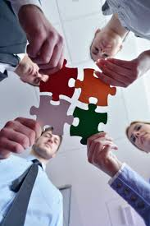
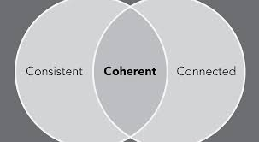
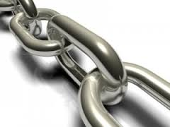
How is your Parallelism? – 5 min
Do your sentences follow the structure that you initiate? Are your verb tenses the same throughout?
2) Does each paragraph relate to your original description?
3) Is there connection between each paragraph?

Slide 6
Begin your revisions ☺
I will be coming around after 10
minutes to help you workshop
your writing.
“Write a personal narrative about an
experience that changed you.”

