Slide 1
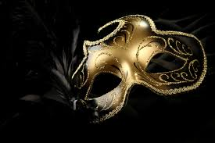
Bellwork:
We wear the mask that grins and lies,
It hides our cheeks and shades our eyes,—
This debt we pay to human guile;
With torn and bleeding hearts we smile,
And mouth with myriad subtleties.
(p. 36) Respond to the poem with first reactions, opinions, etc.
Why should the world be over-wise,
In counting all our tears and sighs?
Nay, let them only see us, while
We wear the mask.
We smile, but, O great Christ, our cries
To thee from tortured souls arise.
We sing, but oh the clay is vile
Beneath our feet, and long the mile;
But let the world dream otherwise,
We wear the mask!

Slide 2
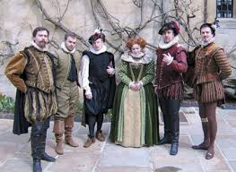
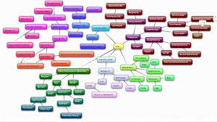
Organizing the cast of characters (15 min)
With a partner, create a map showing connections between the characters
Name relationships on your connecting lines
Some characters may not connect

Slide 3
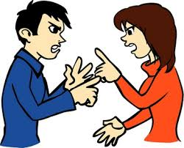
Short Response (5 min)
Based on your connections, what types of conflicts might be present in the play?
Which critical perspectives seem to fit based on your initial mapping?

Slide 4
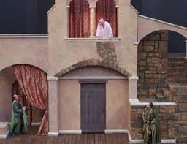
Act 1, Scene 1 (1st)
Iago –
Roderigo –
Brabantio --

Slide 5
Act 1, Scene 1 (2nd)
Iago –
Roderigo –
Brabantio --

Slide 6
Act 1, Scene 1 (3rd)
Iago –
Roderigo –
Brabantio --

Slide 7
Act 1, Scene 1 (4th)
Iago – Campbell
Roderigo –
Brabantio --

Slide 8
Act 1, Scene 1 (6th)
Iago –
Roderigo –
Brabantio --

Slide 9
Act 1, Scene 1 (7th)
Iago – Campbell
Roderigo –
Brabantio --

Slide 10
Vocabulary (p. 47)
bombast
epithet
Moor
obsequious
vexation
timorous
lascivious
promulgate
assay
alacrity
scion
usurp
Use any resources available to define the words to the right
Include a synonym and example with each

