Slide 1
Bellwork (p. 16)
Respond to the following quote:
"Money is the root of all evil."
***Be sure you have a green book nearby

Slide 2
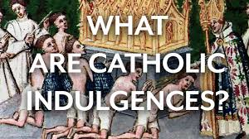
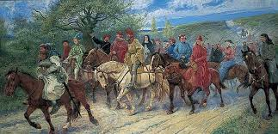
Indulgences & Canterbury (Note on p. 16)

Slide 3
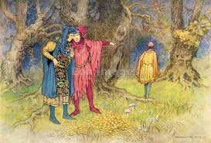
The pardoner’s tale p. 127

Slide 4
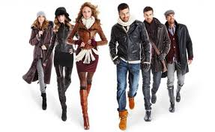
Bellwork (p. 17)_
discuss how clothing choices may reveal an individual’s career, economic status, and personality.
Are there careers or companies that sanction/ promote individuality in clothing selections?

Slide 5
Gallery notes (p. 17)
For each of the following paintings, you will have 30-60 seconds to jot down notes only on what you see. (try not to interpret)

Slide 6
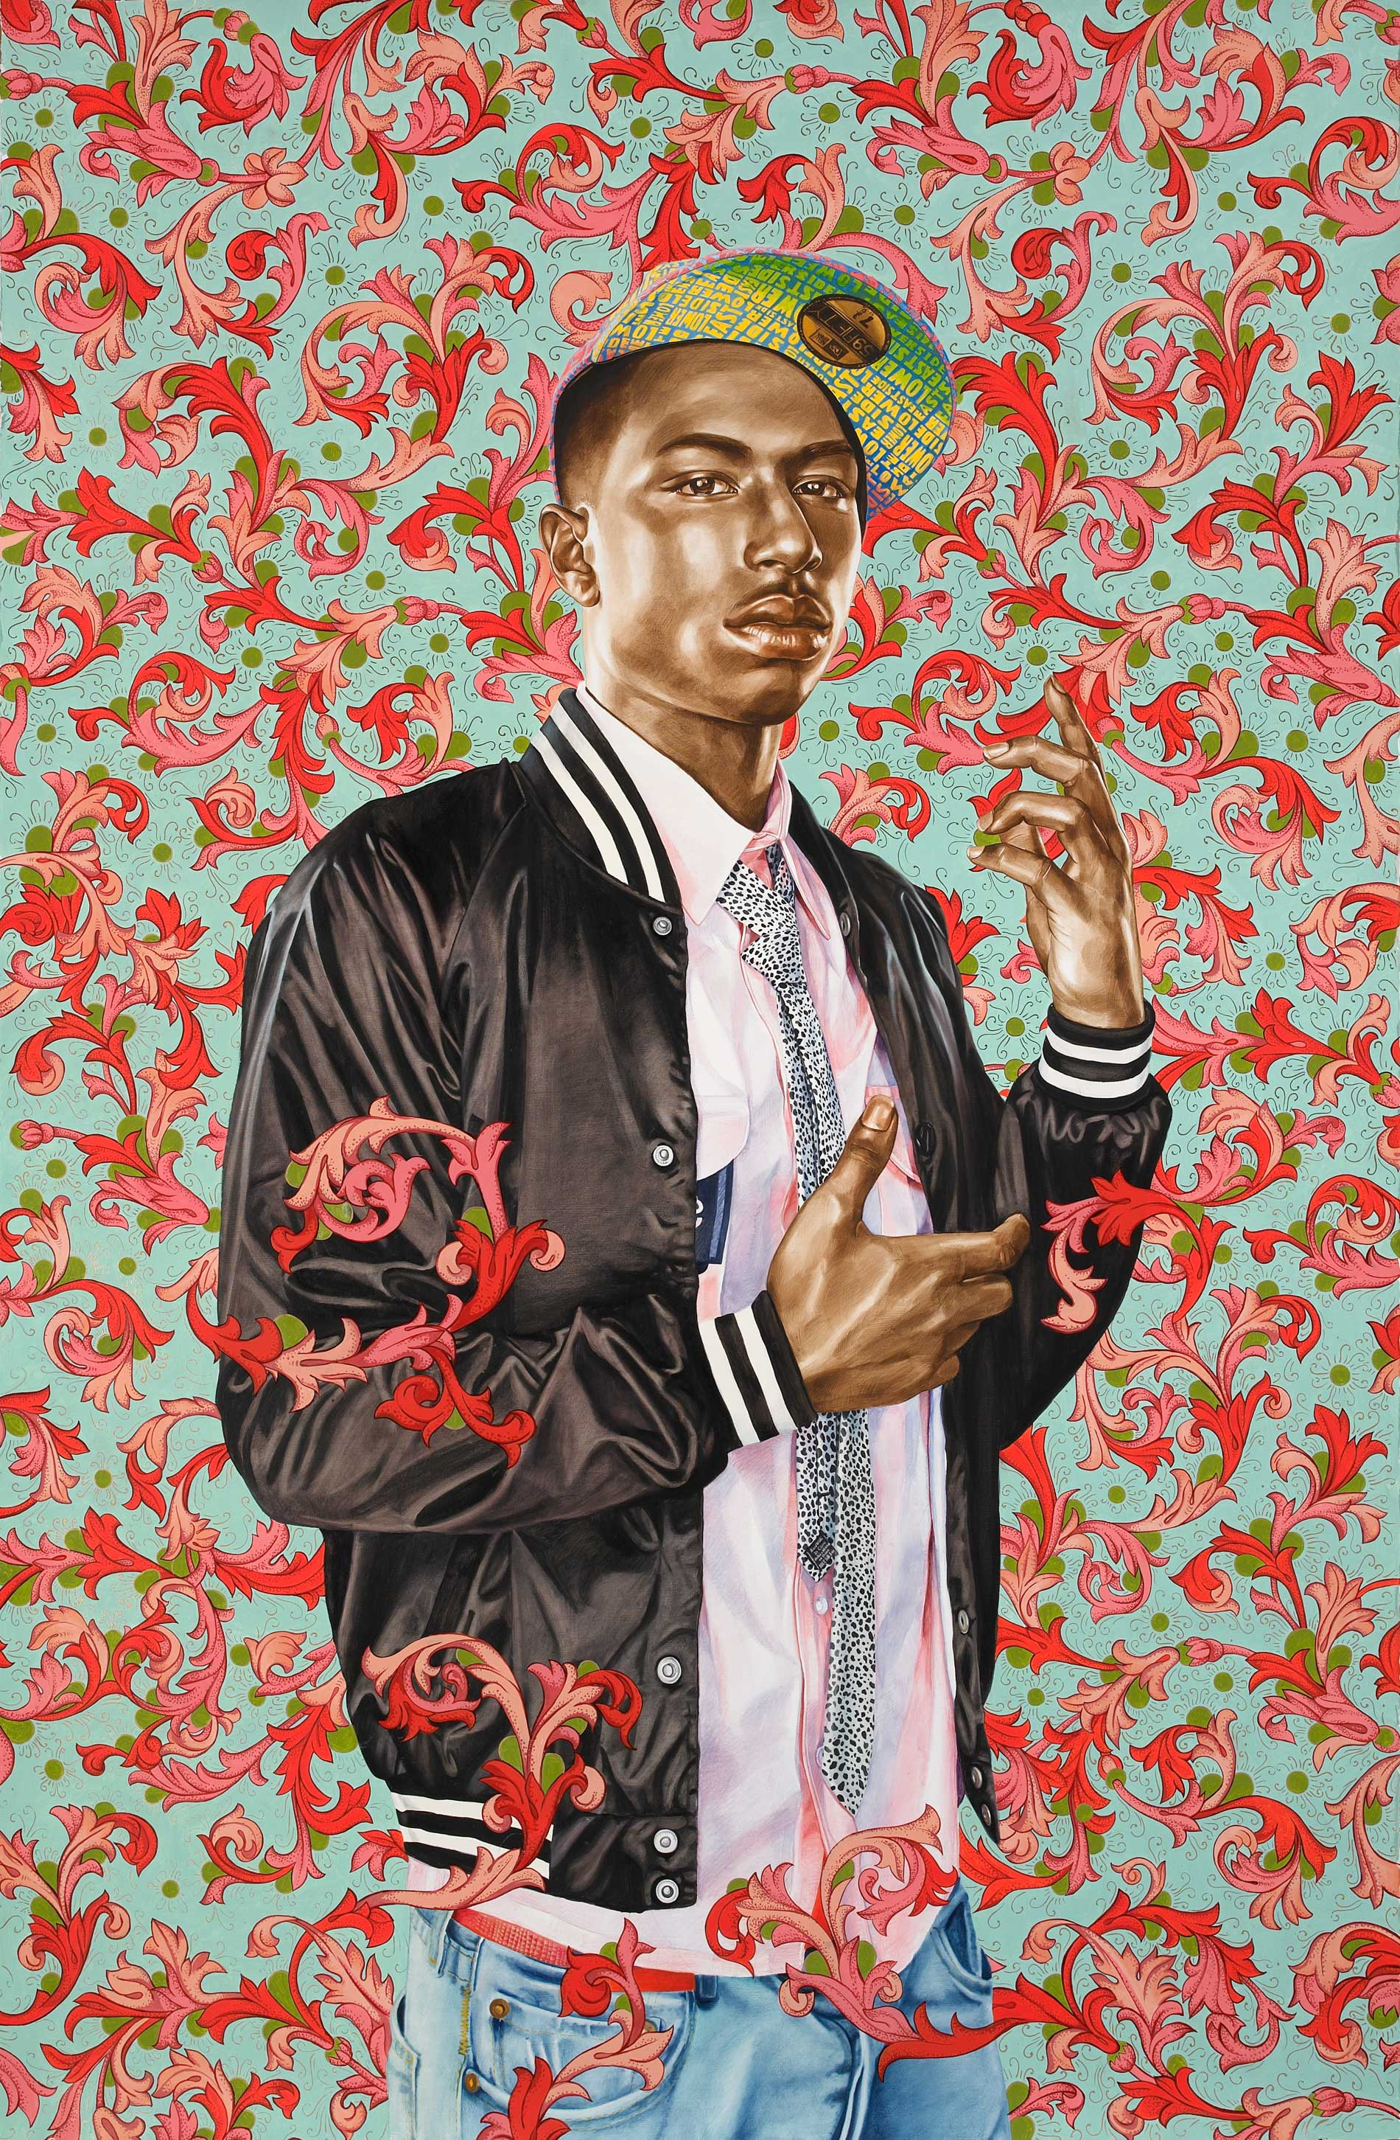

Slide 8
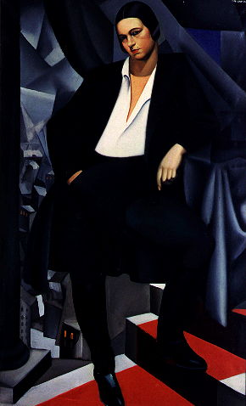

Slide 9
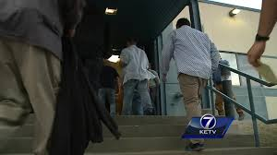

Slide 10
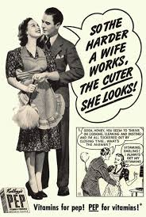

Slide 12
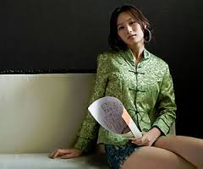

Slide 13
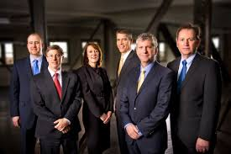

Slide 14
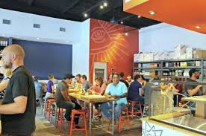
Interpreting the photos
With a partner, interpret the photos you saw
suggested topics:
The person’s potential job
Their age/economic status
Where they fit in society

Slide 15
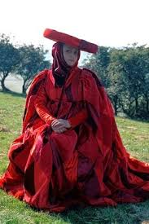
wife of bath description ~~Green book p. 108 lines 455-487

Slide 16
wife of bath description ~~p. 108 lines 455-487 2) Respond to the following 2 questions: a) How are her appearance and actions disconnected? B) how would you describe her in general?

Slide 17
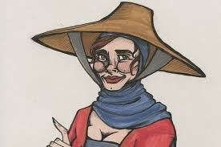
THE WIFE OF BATH’s tale P. 139-145 (the break)

Slide 18
Bellwork (p. 21): 1) in what way(s) is the wife of bath’s tale an early example of feminist writing? 2) How might feminists have been treated during the middle ages?

Slide 19
THE WIFE OF BATH’s tale audiobook P. 145-150

Slide 20
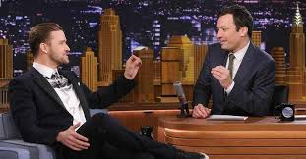
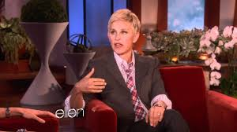
Talk Show scripting -- try rewriting an epilogue as an episode of a talk show -- script should include dialogue from the knight, his wife, and an objective host -- script should run 1-2 min

