Slide 1
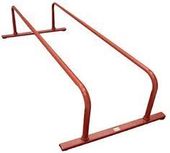
Bellwork
Notebook Table of Contents p. 6-7
“Parallelism”
On p. 6 -- Predict the meaning of parallelism as it relates to writing? Why might this be an important feature?
***be sure you have white books nearby***

Slide 2
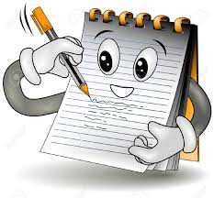
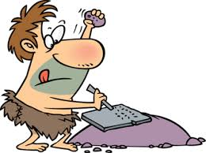
Note-Taking
Continue on page 6
https://prezi.com/odeuakgbcb8b/parallelism/

Slide 3
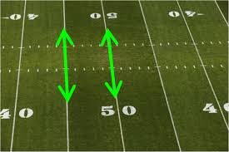
Let’s Practice
White book P. 316 Practice 10
Think about it: did I follow the established pattern?

Slide 4
With a Partner
P. 318 – p. 7 in your notebook?
Practice 11 & 12 (6 fixes)
Think about it: does it follow the established pattern?

Slide 5
Check Your Notebook
Table of Contents:
P. 1 – Scavenger Hunt (attached) & High Expectations Bellwork
P. 2 – Book Pass Activity
P. 3 – Narration Notes and Activities (practice from book and newspaper article)
P. 5 – Subject, Central Idea, and Theme (walk-around activity)
P. 7 – Consistency and Parallelism (notes + 3 sets of exercises)

