Slide 1
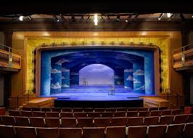
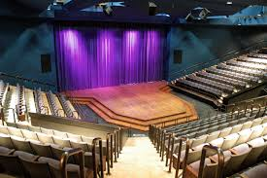
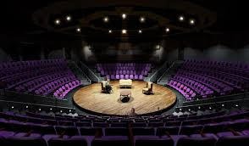
Bellwork (bottom of p. 44)
Weigh the pros and cons of traditional proscenium, thrust, and theatre in the round stages (shown in pics).

Slide 2
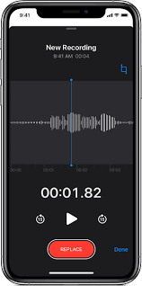
“in the round”…
→ Divide parts
→ Use the voice memo feature on your phone to record your group’s reading of Act 4, Scene 2.
→ Start a new recording every 5 min for easier submission.

Slide 3
Recording a Live Performance
E-mail all files to:
Tyler.Campbell@polk-fl.net
In the subject line, put you group names and period #

