Slide 1
Good morning! You’ll need a laptop and your notebook today
BW (p. 65)
Why would a dislike for the empire have been an unpopular opinion in Victorian times?
Who might have been the biggest critics of empire?

Slide 2
Campeng.weebly.com 3rd Quarter Bottom of page “empire poetry”

Slide 3
Poem 1: “Ulysses” (p. 971)
First, read the poem
Poetryfoundation.org/poems/45392/ulysses

Slide 4
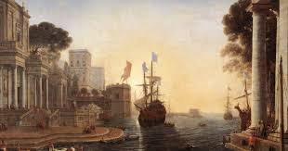
Poem 1: “Ulysses” (p. 971)
1. In general, what is the speaker of this poem suggesting about traveling abroad?
2. Further, what is the speaker saying about the younger generation coming up?
3. How does the author use the imagery of the sea to mirror the passage of life?

Slide 5
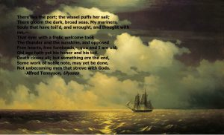
Poem 1: “Ulysses” (p. 971)
According to this poem, the Victorian age was _______________

Slide 6
Poem 2: “Dover Beach” (p. 1042)
First, read the poem
Poetryfoundation.org/43588/dover-beach

Slide 7
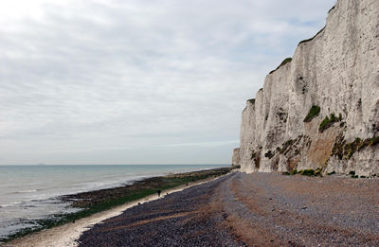
Poem 2: “Dover Beach” (p. 1042)
1. What opinion does the speaker appear to have regarding the Empire?
2. To what is the speaker referring by “The Sea of Faith”?
3. How does the sea function within the poem?

Slide 8
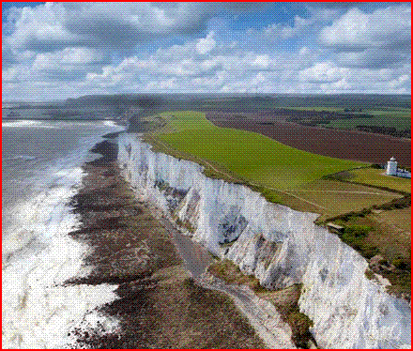
Poem 1: “dover beach” (p. 1042)
According to this poem, the Victorian age was _______________

Slide 9
Poem 3: “recessional” (p. 1046)
First, read the poem
Poetryfoundation.org/poems/46780/recessional

Slide 10
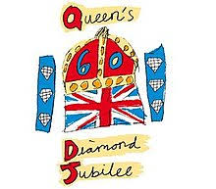
Poem 3: ”Recessional” (p. 1046)
1. In what way(s) is the title indicative of the subject of the poem?
2. Why might the speaker be considered old-fashioned in his thinking?
3. To what effect does Kipling use the various allusions within the poem?

Slide 11
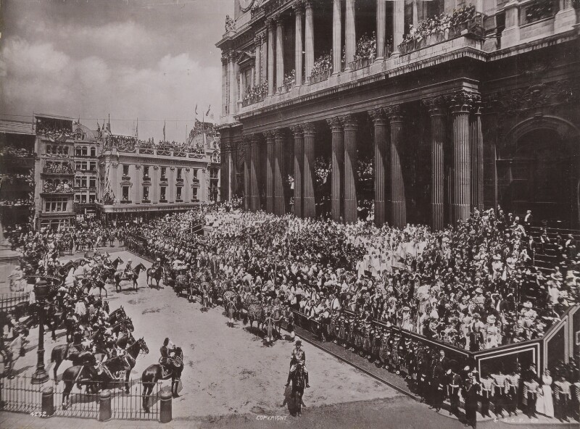
Poem 3: “recessional” (p. 1046)
According to this poem, the Victorian age was _______________

Slide 12
Poem 4: “from lucy: Englan’ Lady” (p. 1055)
First, read the poem on the next slide

Slide 14
Poem 4: ”from lucy: englan’ lady ” (p. 1055)
1. what extended metaphor is used throughout the poem?
2. According to the speaker, why does the queen have such an effect when she visits?
3. Describe the turn in the poem?

Slide 15
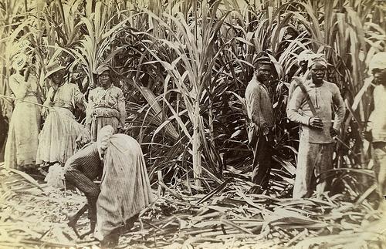
Poem 4: “from lucy: englan’ lady” (p. 1055)
According to this poem, the Victorian age was _______________

