Slide 1
Collage Project
Slide 1) a collage that represents major elements of earnest.
Slide 2) written explanations of the relevance/significance of the images in your collage

Slide 2
Collage Project

Slide 3
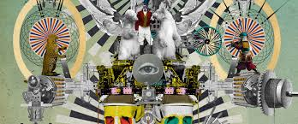
Collage Project

Slide 4
Collage Project

Slide 5
Collage Project
***Traditionally, a collage contains little or no blank space
*** a collage may contain pictures and words
*** BEGIN your image
Search on google images

