Slide 1
Order of Events
now: finish “earnest” (5-10 min)
After: pick up a laptop and log into google slides
then: Earnest collage project (30-35 min)

Slide 2
Collage Project
Slide 1) a collage that represents major elements of earnest.
Slide 2) written explanations of the relevance/significance of the images in your collage

Slide 3
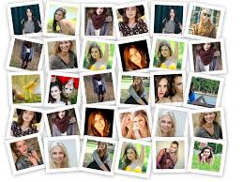
Collage Project

Slide 4
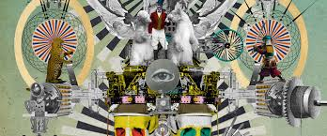
Collage Project

Slide 5
Collage Project

Slide 6
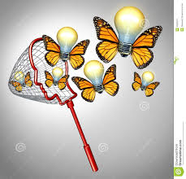
Collage Project
***Traditionally, a collage contains little or no blank space
*** a collage may contain pictures and words
*** BEGIN your image
Search on google images

