Slide 1
Bellwork: copy table below to p. 15 in notebook
Coherence Method | Between/Within Sentences | Replacement/ Addition | Other Notes
ORDERING
REPETITION
SYNONYMS/ SUBSTITUTIONS
TRANSITIONS

Slide 2
Bellwork (10-15 min)
Campengblog.wordpress.com (on your phone)
Tap on “Workplace Blogging” post
Follow posted instructions → write your responses as a comment in the box at the bottom
**Pick up a white Evergreen book from shelf**

Slide 3
TIME/ CHRONOLOGICAL ORDER
Green box bottom p. 46
Look for the “time stamps”

Slide 4
TIME/ CHRONOLOGICAL ORDER
Practice 1 with your partner (p. 15)
Only need a list of numbers
(3rd one on next page)

Slide 5
SPACE ORDER
Top to bottom/left to right/front to back/inside out
Think like a camera
Green box top of p. 49 together

Slide 6
SPACE ORDER
Practice 3 with your partner (p. 15)

Slide 7
ORDER OF IMPORTANCE
Most to least ~OR~ least to most
Green box p. 52 together

Slide 8
ORDER OF IMPORTANCE
Practice 4 on your own (p. 15-16)

Slide 9
Show What You Know (p. 16)
Create a paragraph that shows either space order or order of importance as discussed today

Slide 10
p. 15 in your notebook
Coherence Method | Between/Within Sentences | Replacement/ Addition | Other Notes
ORDERING | INSERT | INSERT | INSERT
REPETITION
SYNONYMS/ SUBSTITUTIONS
TRANSITIONS

Slide 11
Bellwork (p. 23): For each scenario, give the type of ordering that creates the most coherence
The parts of a car engine
Events at a contest
A list of homework tasks
A landscape painting
Improvements to a park

Slide 12
REPETITION
Coherence can also be achieved by repeating important words and ideas
Green box p. 55 together
CAUTION
Practice 5 with your partner
Two columns – repeated words and pronouns that replace them

Slide 13
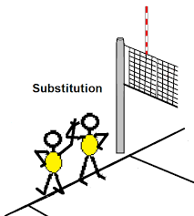
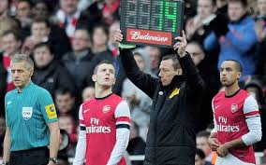
SUBSTITUTIONS/SYNONYMS
Repetition can also be achieved by using synonyms or substituting phrases
P. 58 Practice 6
Paragraph 1/2 together
P. 60 Practice 7 with your partner
Pick 1

Slide 14
TRANSITIONS
Words and phrases that point out exact relationships between ideas
P. 64 Practice 9 with your partner (use chart on 63)

Slide 15
Finishing the chart
Coherence Method | Between/Within Sentences | Replacement/ Addition | Other Notes
ORDERING
REPETITION
SYNONYMS/ SUBSTITUTIONS
TRANSITIONS

Slide 16
BEFORE YOU LEAVE/HW:
Create 3 paragraphs of at least 5 sentences each that correctly show coherence
One should be space order or order importance
The other two may be any of the other 3 methods discussed
***See the “Writing Assignment” Sections in this chapter for ideas if you need them***

