Slide 1
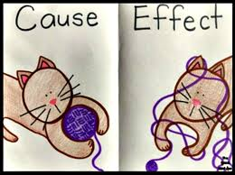
Bellwork (p. 51)
Why is the study of causes and effects worth our time? What everyday benefit could be offered from better understanding these relationships?
***you’ll need a white book from the shelf!

Slide 2
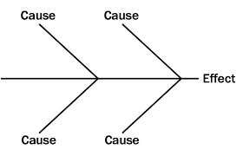
Notes (p. 51)
Multiple causes leading to one effect
Complex events for which multiple factors played a part
Think causes of war

Slide 3
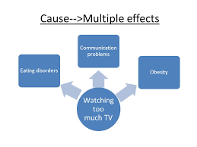
Notes (p. 51)
One cause leading to multiple effects
Requires thinking in both short and long terms
Chain could continue with further effects

Slide 4
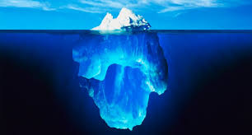
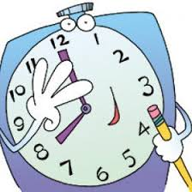
Notes (p. 51)
Caution!
Oversimplification of complexity
Time order does not mean causation
Confusing causes and effects

Slide 5
Notes (p. 51-52)
Reasons

Slide 6
Practice 1 white book p. 150 (notebook p. 52)

Slide 7
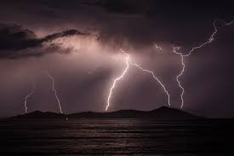
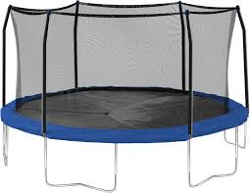
Practice 2-3 white book p. 151-152
***finished early? Check out the first link on p. 154

Slide 8
Extend the chain add a long-term effect to practice 2

