Slide 1
Bellwork:
***Webquests in the clear bin on my desk
Table of contents → p. 10 – epics p. 11 – Beowulf cont. p. 12 – anglo saxon heroes on p. 10 → What are the qualities of an epic story? What common traits should we see in an epic hero?

Slide 2
Coming up… th - T: Beowulf parts 1-3 W - Th: Beowulf film

Slide 3
Beowulf Green book p. 40

Slide 4
Key points (copy on p. 10):
1) Hrothgar and his men in the hall (Herot)
4) Hrothgar remains untouched
The Wrath of Grendel
p. 40
2) Grendel visits nightly to kill
3) Herot empties out

Slide 5
Key points:
1) Beowulf decides to go help
4) No fear of death
The Coming of Beowulf
2) Instant test for the Geats
3) Beowulf to fight barehanded

Slide 6
Key points (with your seat mates):
1)
4)
The Battle with Grendel
p. 49
2)
3)

Slide 7
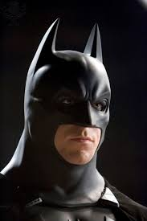
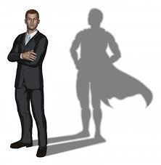
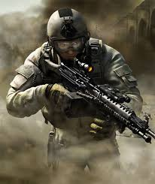
Bellwork:
on p. 11 → Who is Beowulf’s modern equivalent? On what grounds?

Slide 8
Key points (p. 11-12):
Time Estimate
~~ 10 + 15 min
The Monster’s Lair
p. 51
2-3 key points
Grendel’s Mother
p. 52
4 key points
Green light for music while you read

Slide 9
Bellwork (p. 12-13)
Complete last 3 rows from friday
Insert
Insert
Insert
Insert
Insert
Insert
Insert
Insert
Insert

Slide 10
Snapshots activity: creating an archetype
3 images that fit within a single “archetype”
Think: in what category are you looking for examples?

Slide 11
Snapshots activity: submitting
Compile your images into a single, public post on twitter or Instagram
In your caption, include: the archetype, group member names,
#campengbeowulf

Slide 12
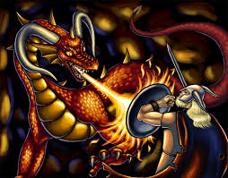
Audiobook pt. 3 (p.56)
The Last Battle
The Spoils
The Farewell

Slide 13
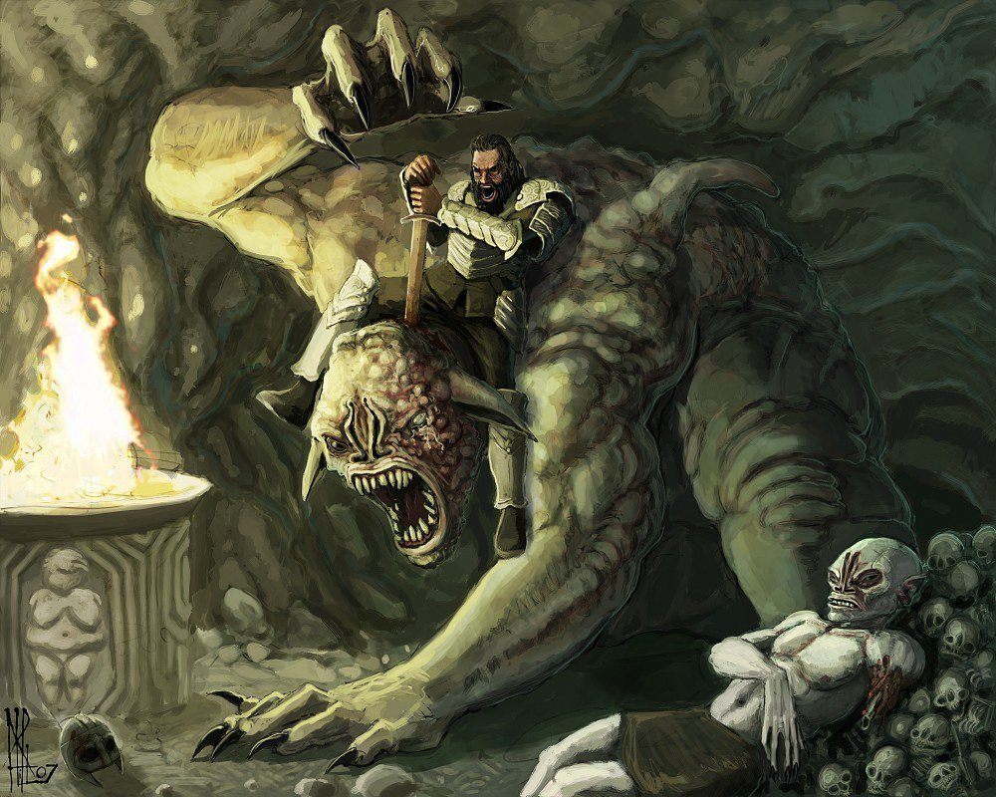
wrap-up (p. 13)
With a partner, analyze the text to determine 5 character traits the anglo-Saxons would have valued. Include a textual reference to support each claim.

Slide 14
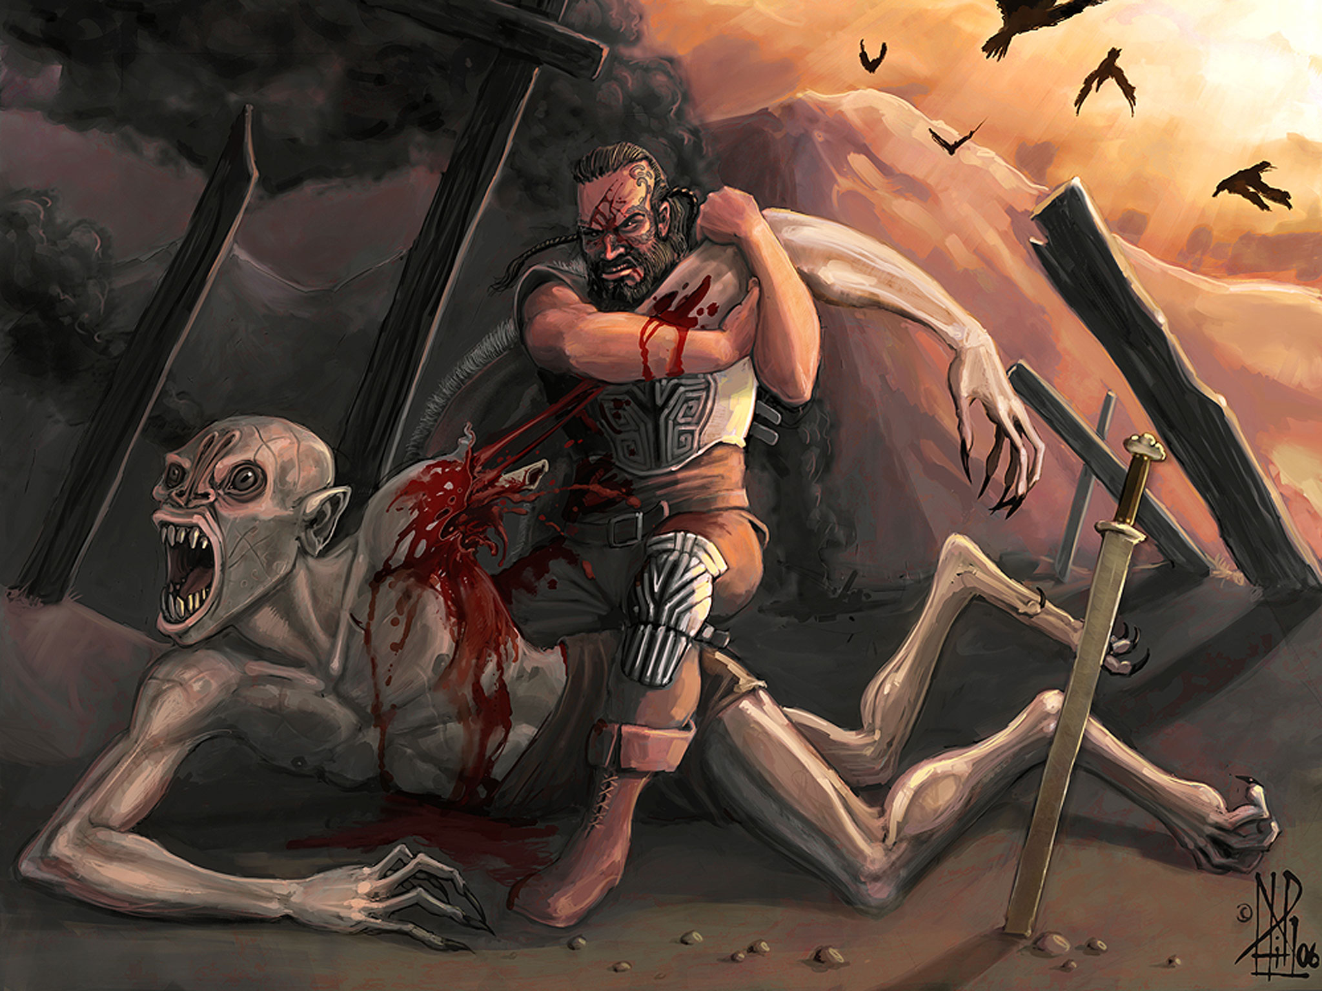
Bellwork [option]:
on p. 11 → Give a description of your reading so far, assuming a person has never read the text.

Slide 15
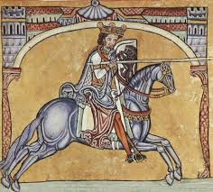
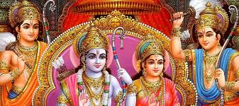
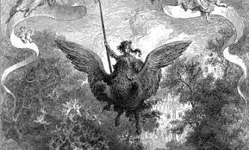
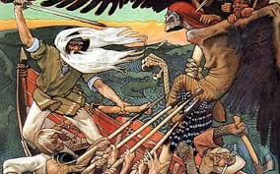
Global epics [option]
1) using your device, research the story given to your group (10 min)
2) Be ready to share out

