Slide 1
First Questions… (p. 25)
What is an argument?
How can an argument be made stronger?
(You will also need a white Evergreen book)

Slide 2
Coming Up…2nd Quarter
Fri – Argument Practice; All Work Due
Mon – No School
Tues – Competing Arguments
Wed – Cold Write Unit 2
Thurs/Friday – Ballads

Slide 3
About Quarter 2…

Slide 4
Argument
Making Your Claim Heard

Slide 5
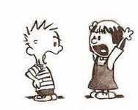
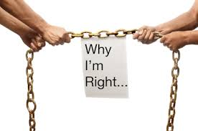
What is argument?
Trying to convince someone that a particular opinion is the correct one
Uses logical, rational ideas and support

Slide 6
Claim
States what the writer is arguing for/against
Ex: Passengers should refuse to ride in any vehicle driven by someone who has been drinking.

Slide 7
Supporting Your Claim - Facts
State what is
Appeal to the mind, not emotions
Should come from a clear source (don’t say “everyone knows…”

Slide 8
Supporting Your Claim – Refer to Authority
An authority is an expert on a subject
Avoid referring to interesting or glamorous “authorities”

Slide 9
Support Your Claim -- Examples
Should clearly relate to the claim
Look for examples that are typical and common to many people

Slide 10
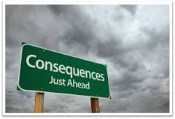
Support Your Claim – Predict the Consequence
What will happen if something does/does not happen
Avoid exaggeration of consequences

Slide 11
Support Your Claim – Answer the Opposition
Counterclaim
Shows awareness and a willingness to respond
Avoid putting down the opposite side, but rather say why your claim is important and different

Slide 12
What About Those Greek Words?
Pathos -- appeal to emotion
Ethos – appeal to ethics/credibility
Logos – appeal to logic/reason

Slide 13
What About Those Greek Words?
Pathos -- appeal to emotion
Predicting Consequence
Examples
Answer Opposition
Ethos– appeal to ethics/credibility
Authority
Logos -- – appeal to logic/reason
Facts

Slide 14
~~Your Turn~~
With your group/partner/solo, read the paragraph in the green box at the top of p. 156 then answer the bullet points beneath it

Slide 15
Consider Your Audience

Slide 16
~~Your Turn~~
On Your Own
Practice 1 ~OR~ 2 p. 160-161
Read the paragraphs, then answer the questions below
Hints: #1 → opinion statement
#2 → be as specific as possible (consider the subject)

