Slide 1
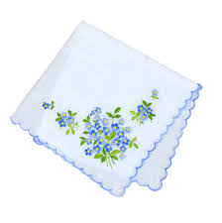
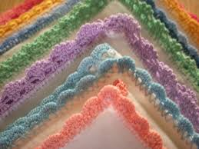
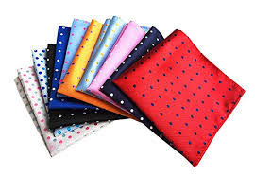
bellwork: [p. 42-43] [5 min]
Brainstorm potential uses for a handkerchief
How might such an insignificant object obtain importance?

Slide 2
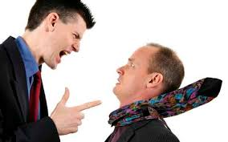
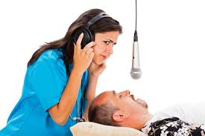
2.3 group reading [p. 43]
1. Handkerchief plans
5. “3 days time”
4. Othello’s decision
2. Threats to Iago
[p. 149/line 320]
As you read, use the images to help you trace remaining events
3. Other proof

Slide 3
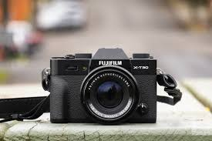
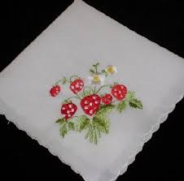
Photo shoot activity
Out on campus, Look for 3 objects that can both help and inhibit a person
Ex: a door keeps harmful things out, but can prevent a person from getting in

Slide 4
Submitting photos
Post your photo to twitter or Instagram using the hashtag: #campengothello
Caption should include all group names and explanation of objects

